Slide 1

Team “SHADDA-BI-BORAN”
presents

Slide 2
GitHub :
https://github.com/KonstantinYanchev/FirstProject-May-Course
Trello :
https://trello.com/b/3wGLSMF2/softuni-projects

Slide 3
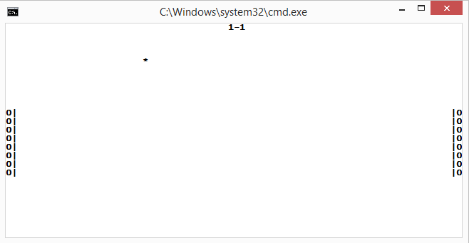
Live Demo!

Slide 4
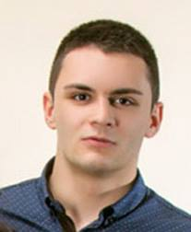

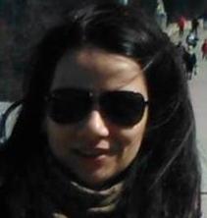
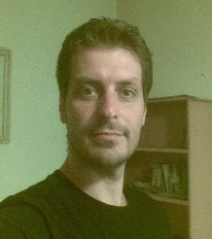
Team members :
Contribution :
Konstantin Yanchev -
25 %
Peter Borisov -
25 %
Tatyana Miteva -
25 %
Slavi Zekov -
25 %

Slide 5

Thanks for your attention.

